Slide 1
CSC 3210 Computer Organization and Programming
Lab Work 5
Dr. Zulkar Nine
mnine@gsu.edu
Georgia State University
Spring 2022

Slide 2
Learning Objective
Listing File Format
Variable declaration
Data types
Comments
String
DUP operator

Slide 3
Lab Work 5 Instructions
Lab 5(a): Create a project and generate listing file (2 points)
Detailed instructions are in Slide 37 and 38
Lab 5(b): Write a program to evaluate an expression with variables (3 Points)
Lab 5(c): Write a program to see the data items in an array (2 points)
Lab 5(d): Write a program to find the size of the string (1 points)
Due Date: Posted on iCollege

Slide 4
Disclaimer!
The process shown in these slides might not work in every single computer due to Operating system version, Microsoft Visual Studio versions and everything.
If you find any unusual error, you can inform the instructor
Instructor will help you resolve the issue.

Slide 5
Attendance!

Slide 6
How to create a Listing File
in Microsoft Visual Studio

Slide 7
Steps to follow
Step 1: Create a new project
Step 2: Configure settings for listing file
Step 3: Build project
Step 4: Open listing file

Slide 8
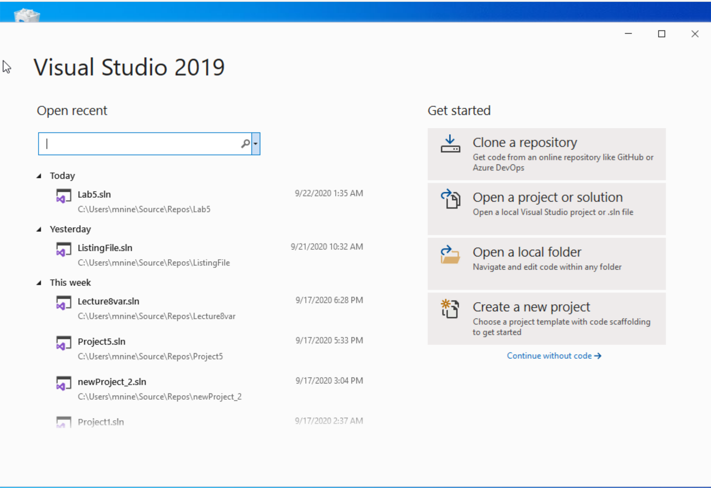


Step 1: Create a project (1)
Start Visual Studio
Click Create a new Project

Slide 9
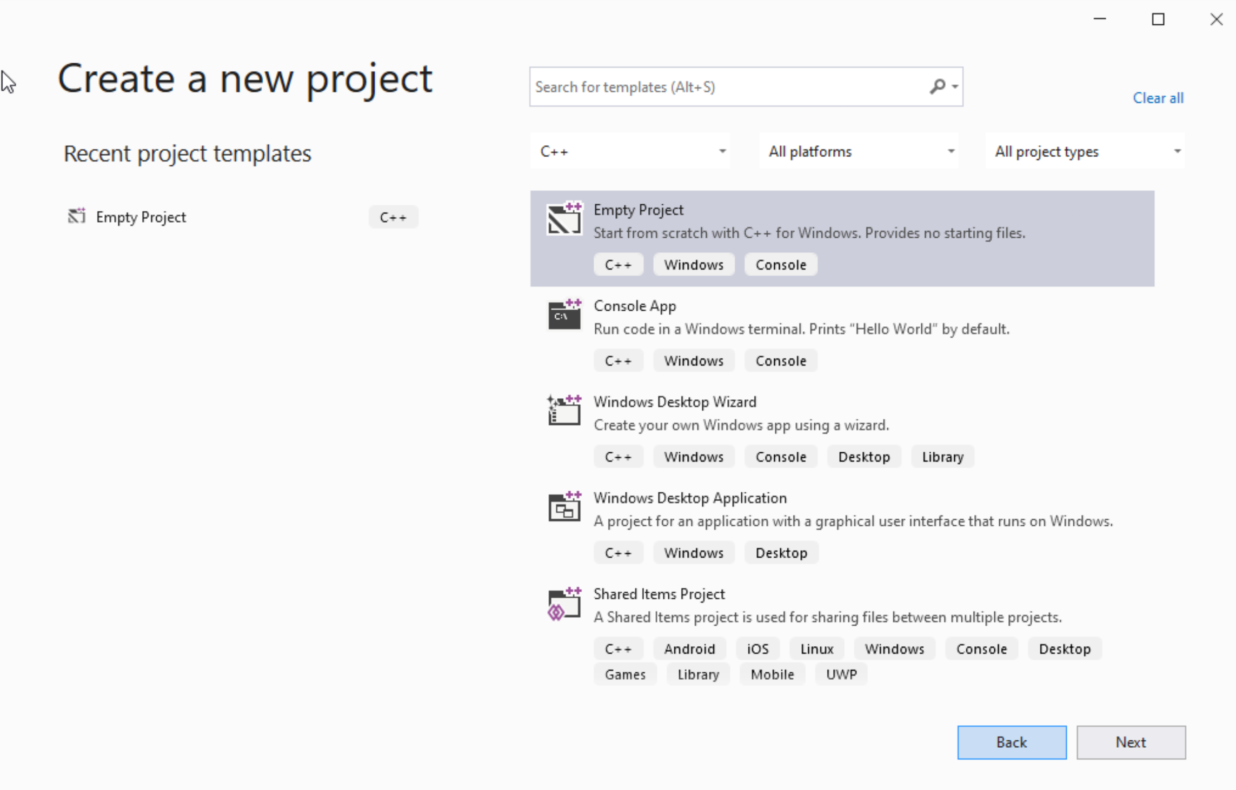




Step 1: Create a project (2)
Select C++ as language
Select Empty Project
Click Next

Slide 10
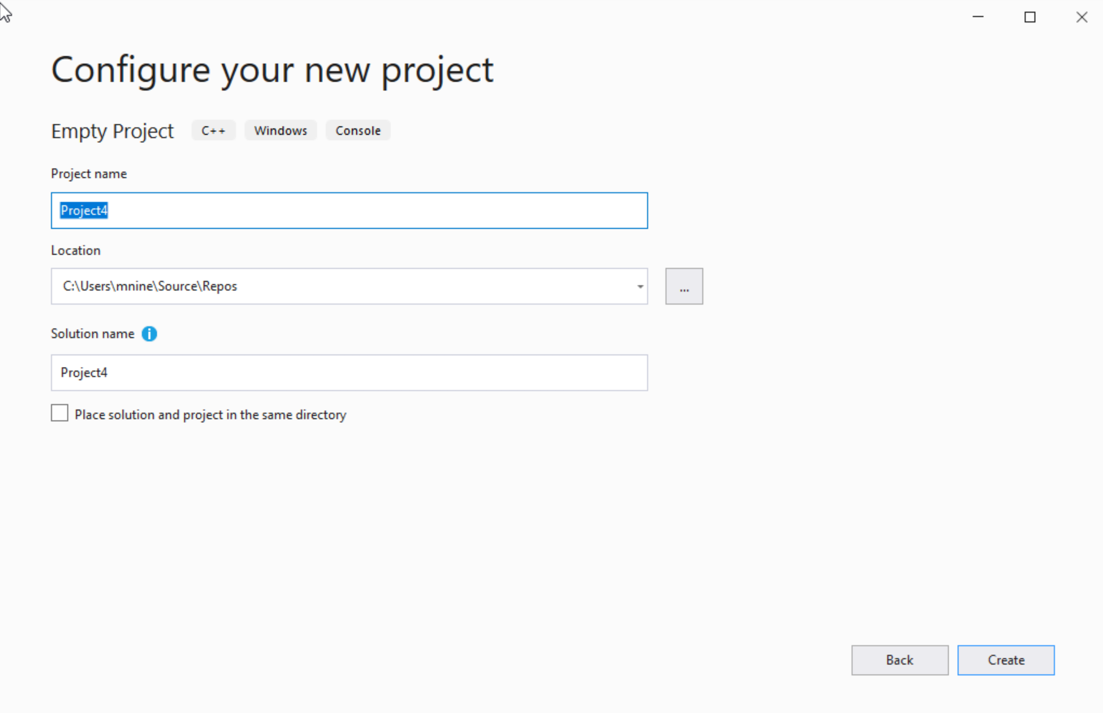

Step 1: Create a project (3)
You can change the project
name as you like
Also, you can change the
project location
Click Next

Slide 11
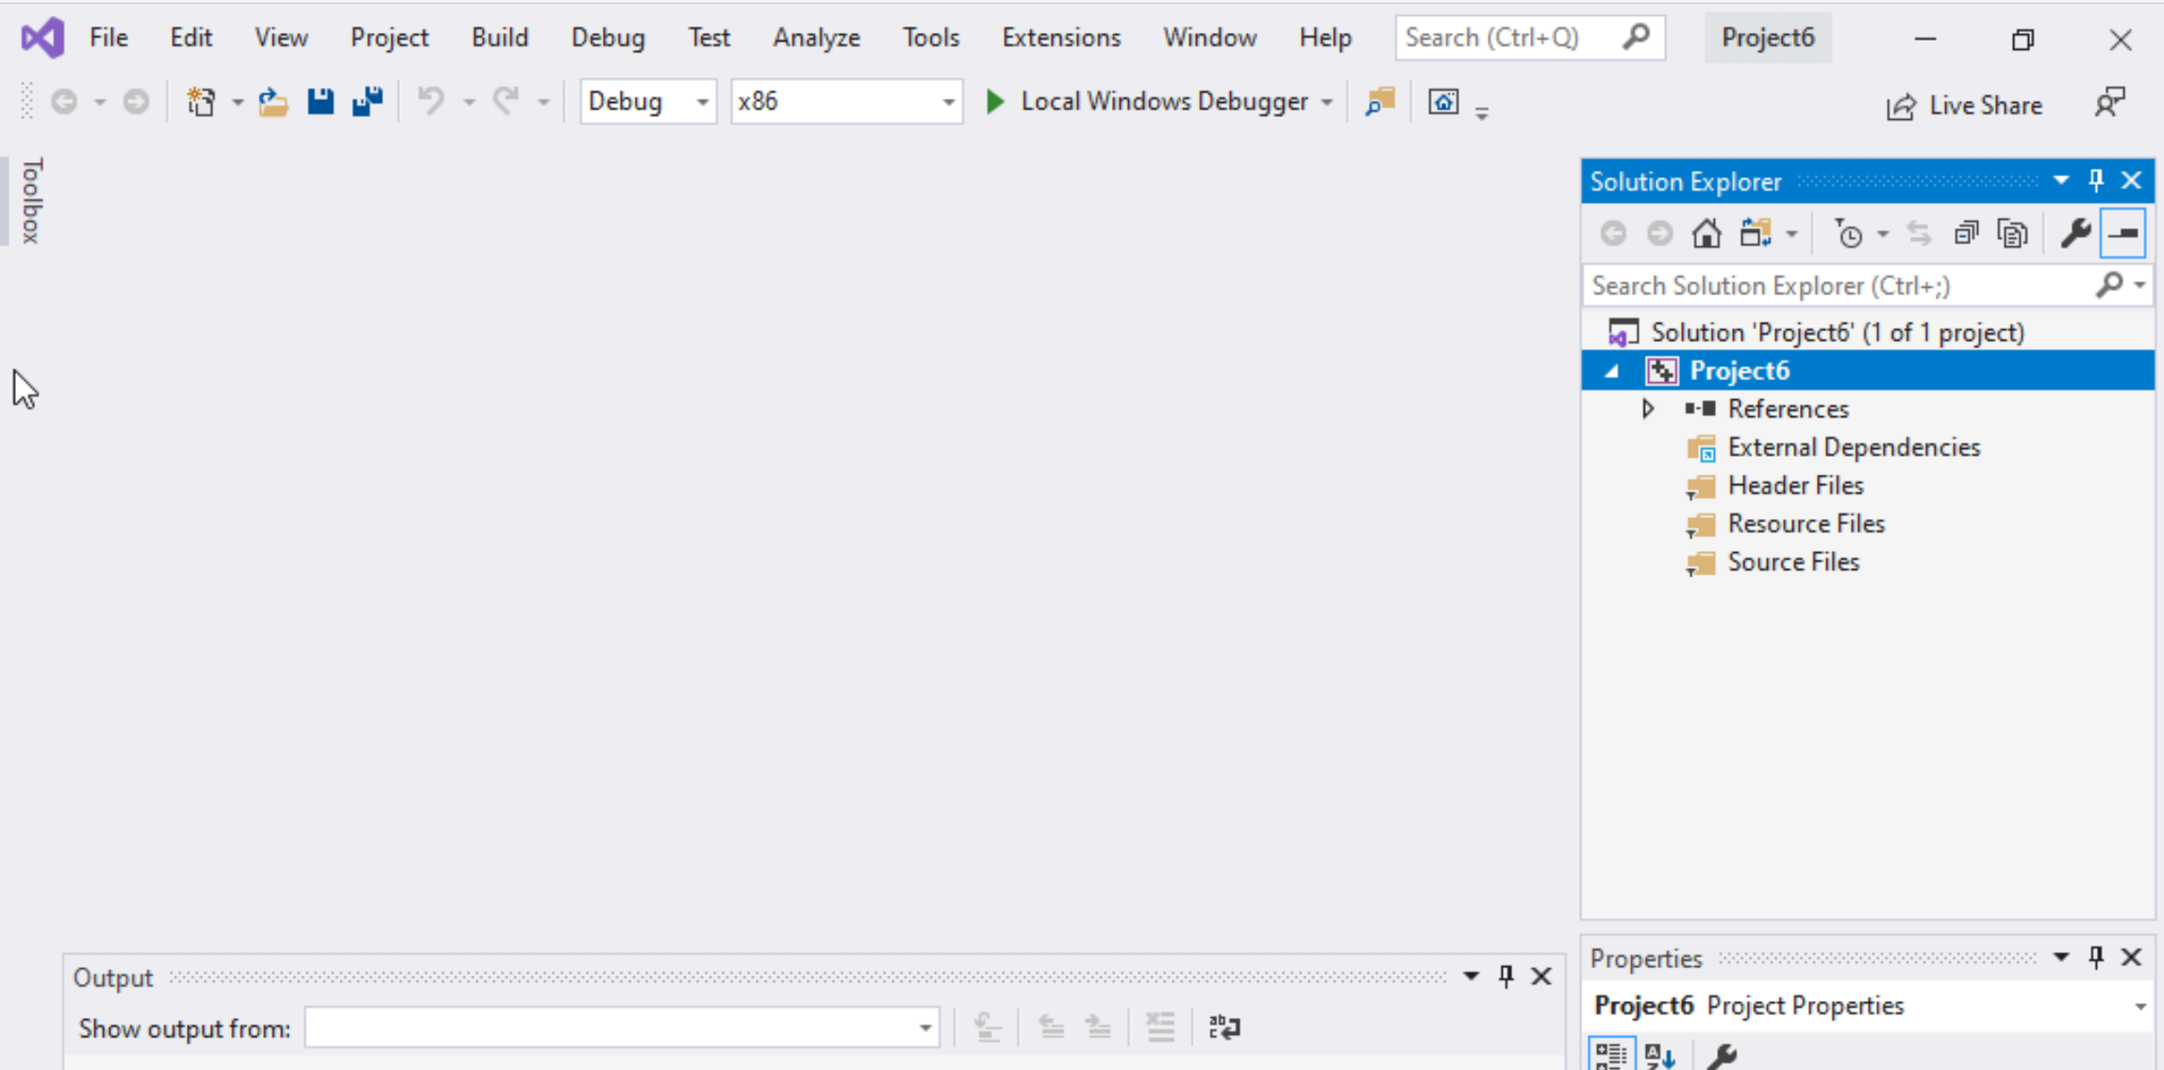
Step 1: Create a project (4)
Delete the
Following folders:
Header files
Resources Files, and
Source Files

Slide 12
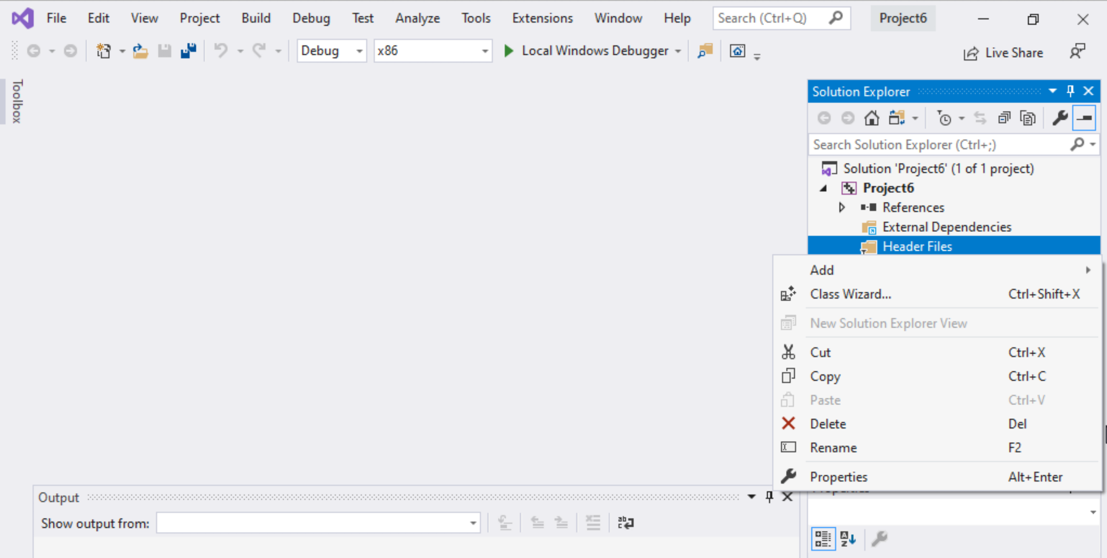
Step 1: Create a project (5)
To delete :
Select the folders
Right click on it
Select delete

Slide 13
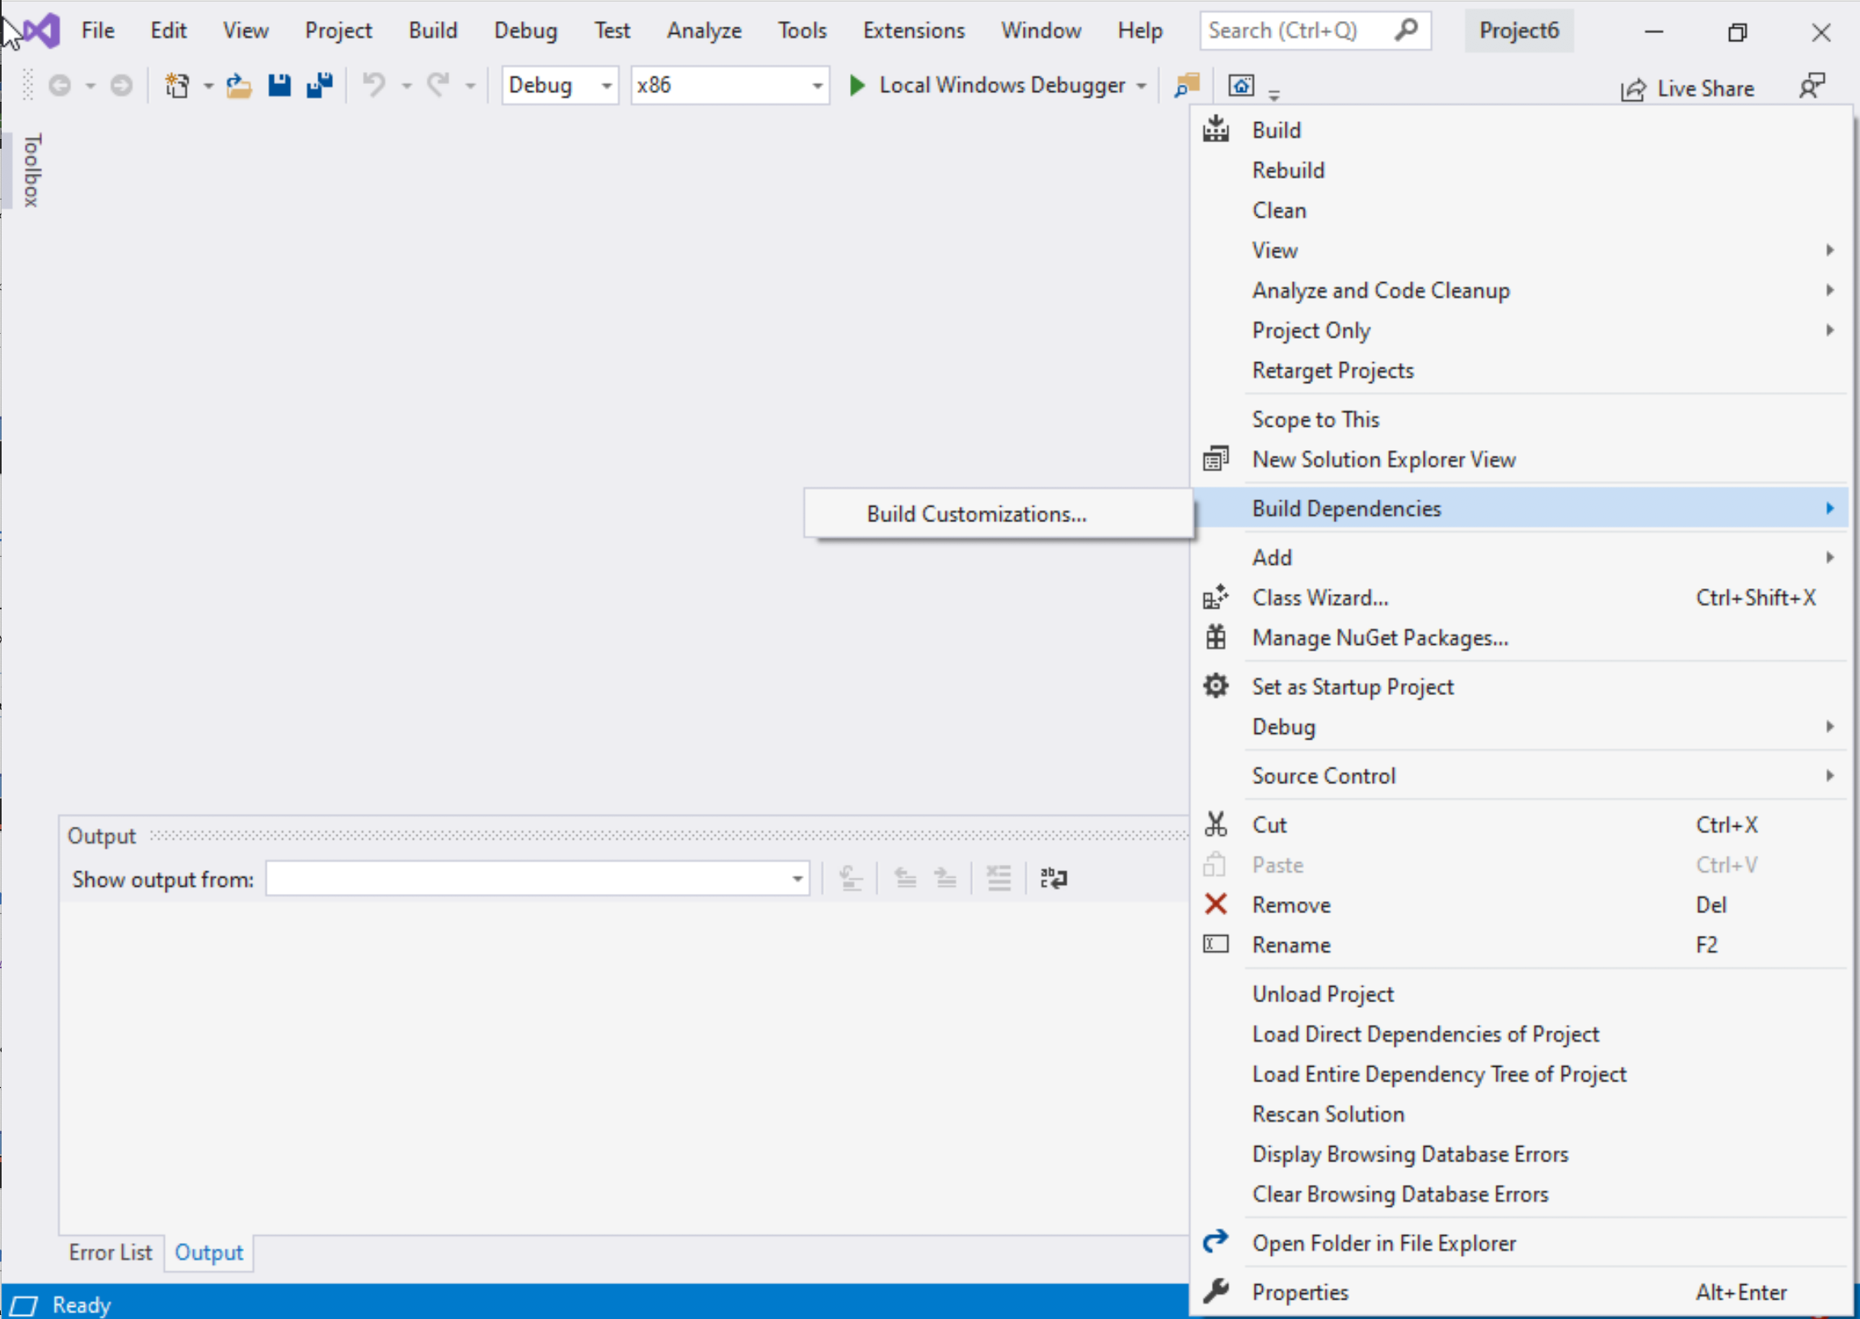
Step 1: Create a project (6)
Select Project Name on solution explorer
Right click on it
Go to Build Dependencies
Click on Build Customizations

Slide 14
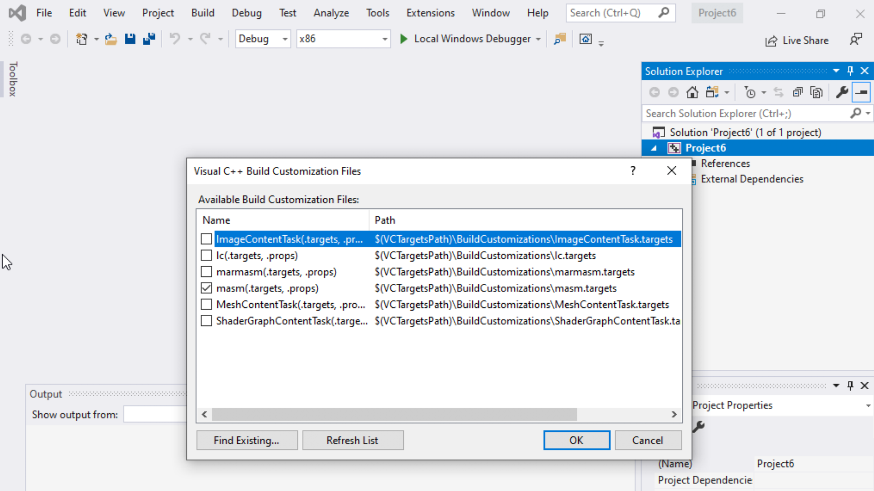
Step 1: Create a project (7)
Select masm(.target, .props)
Click ok

Slide 15
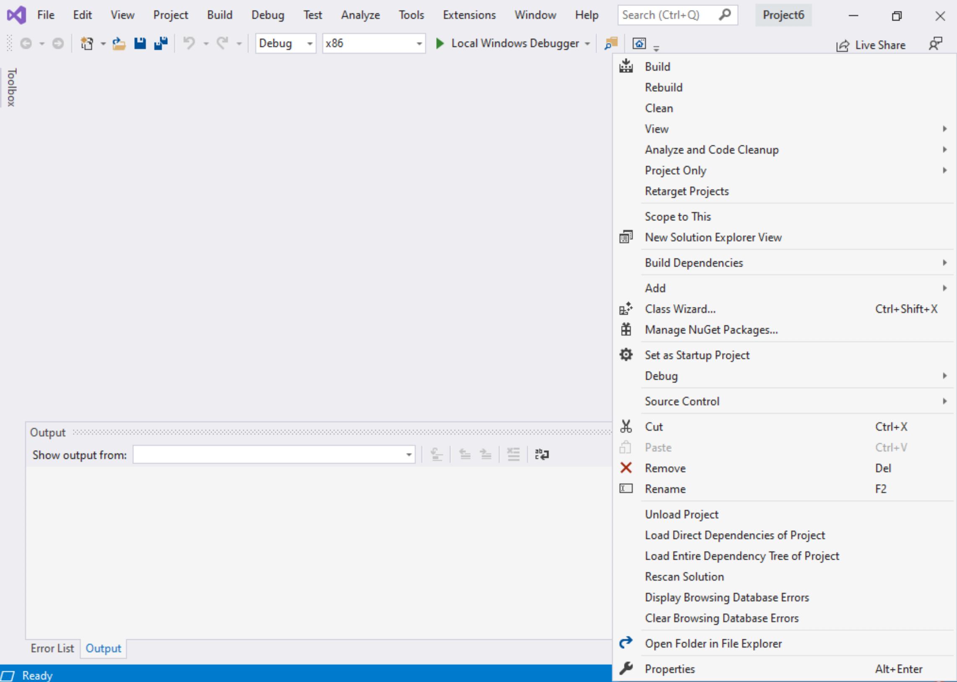
Step 1: Create a project (8)
Right click on the Project name in the solution explorer
Click properties

Slide 16
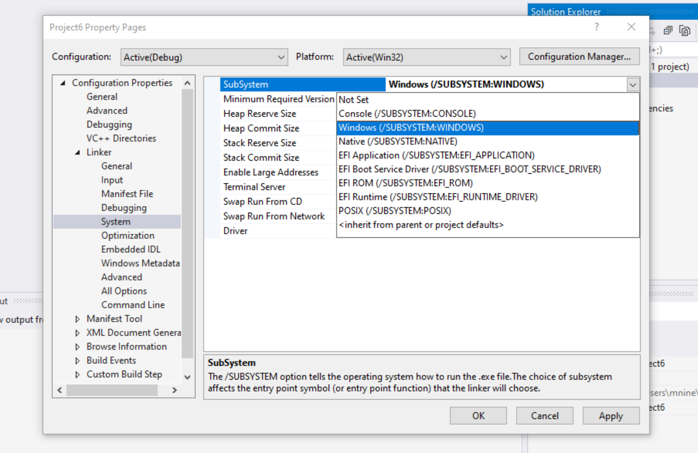

Step 1: Create a project (9)
Expand the ‘Linker’
Select ’System’
Select Windows(/SUBSYSTEM:WINDOWS)
Click OK

Slide 17
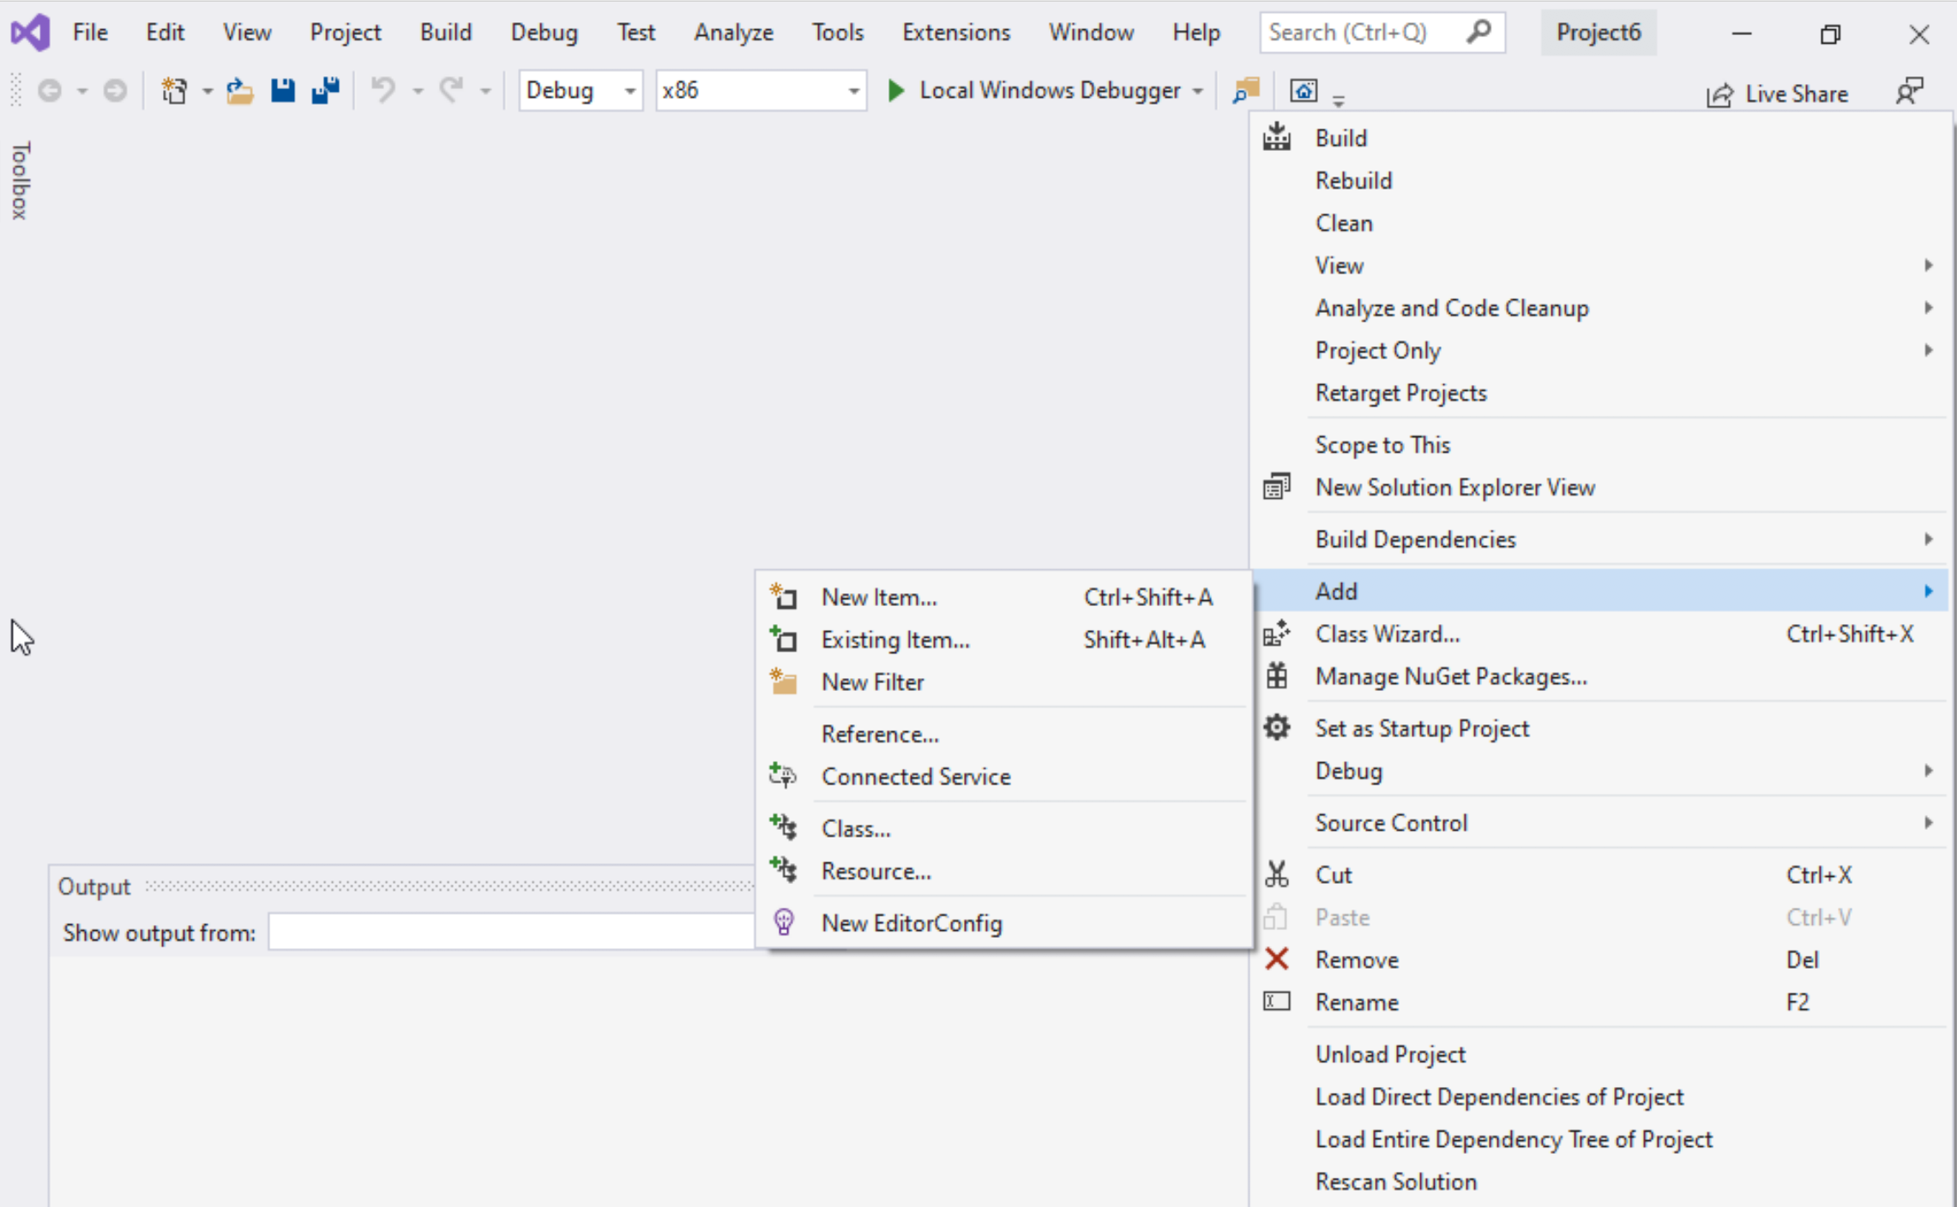
Step 1: Create a project (10)
Select Project name on solution explorer
Right click on it
Expand Add
Choose New Item

Slide 18
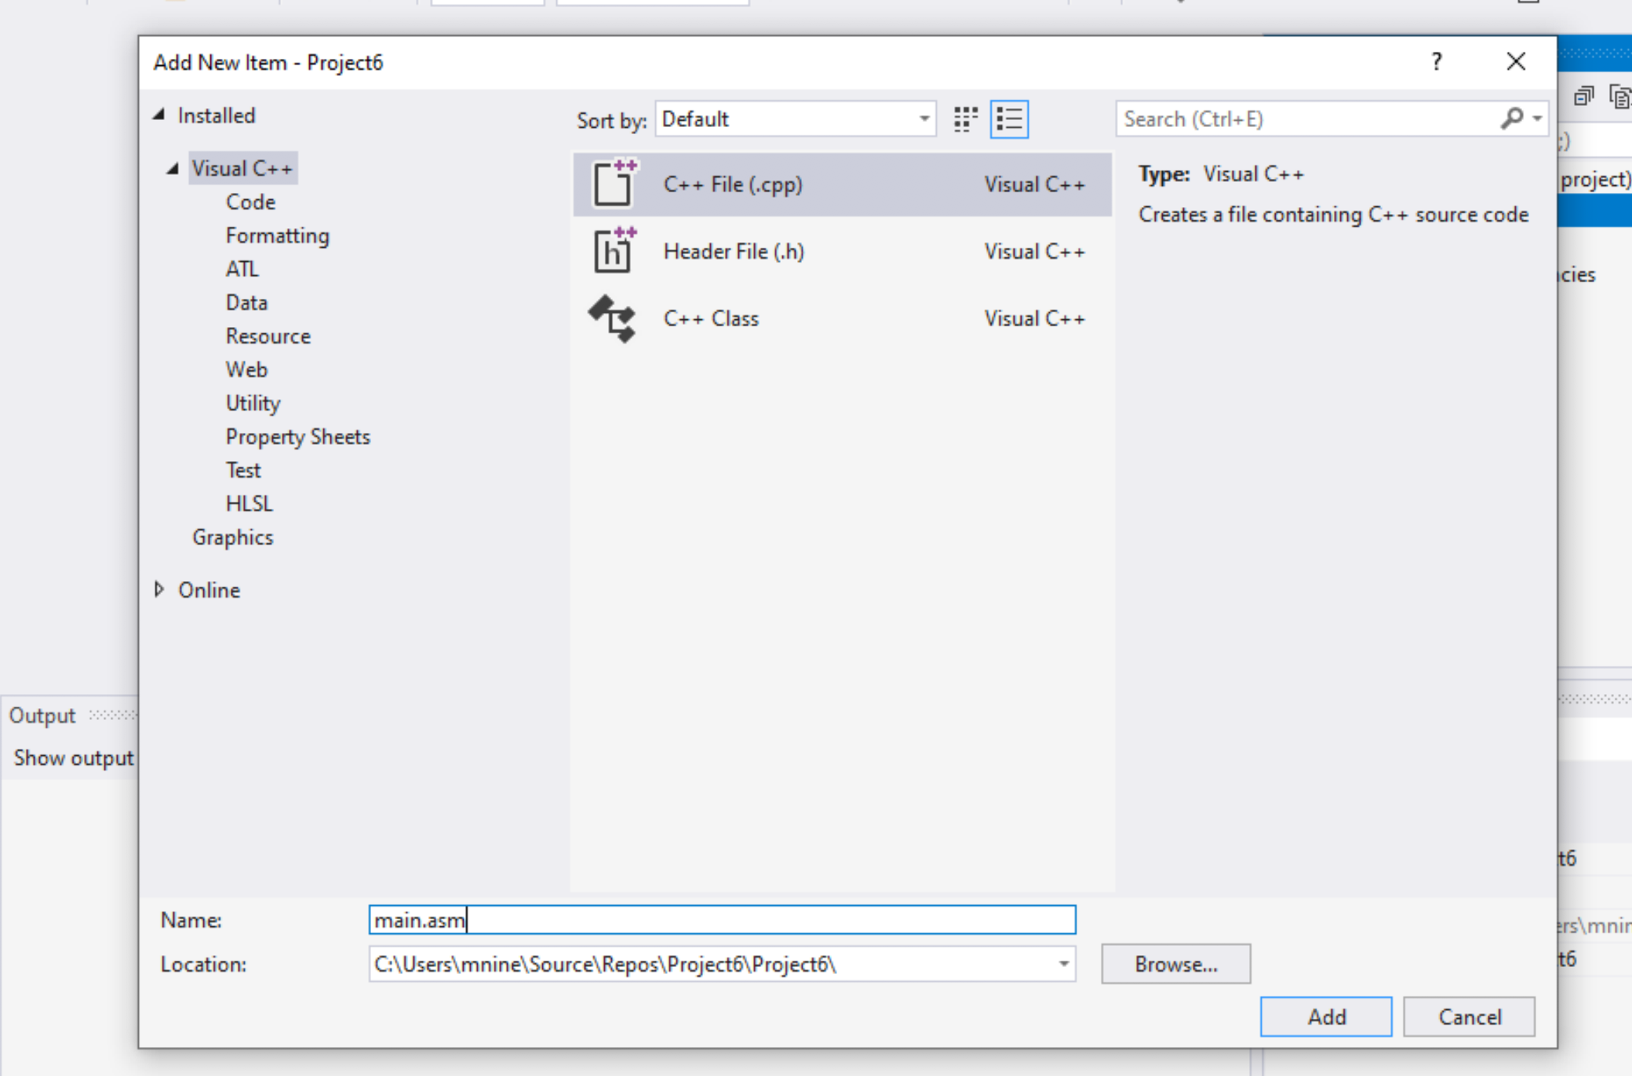


Step 1: Create a project (11)
Select C++ File(.cpp)
Name: main.asm
Click Add

Slide 19
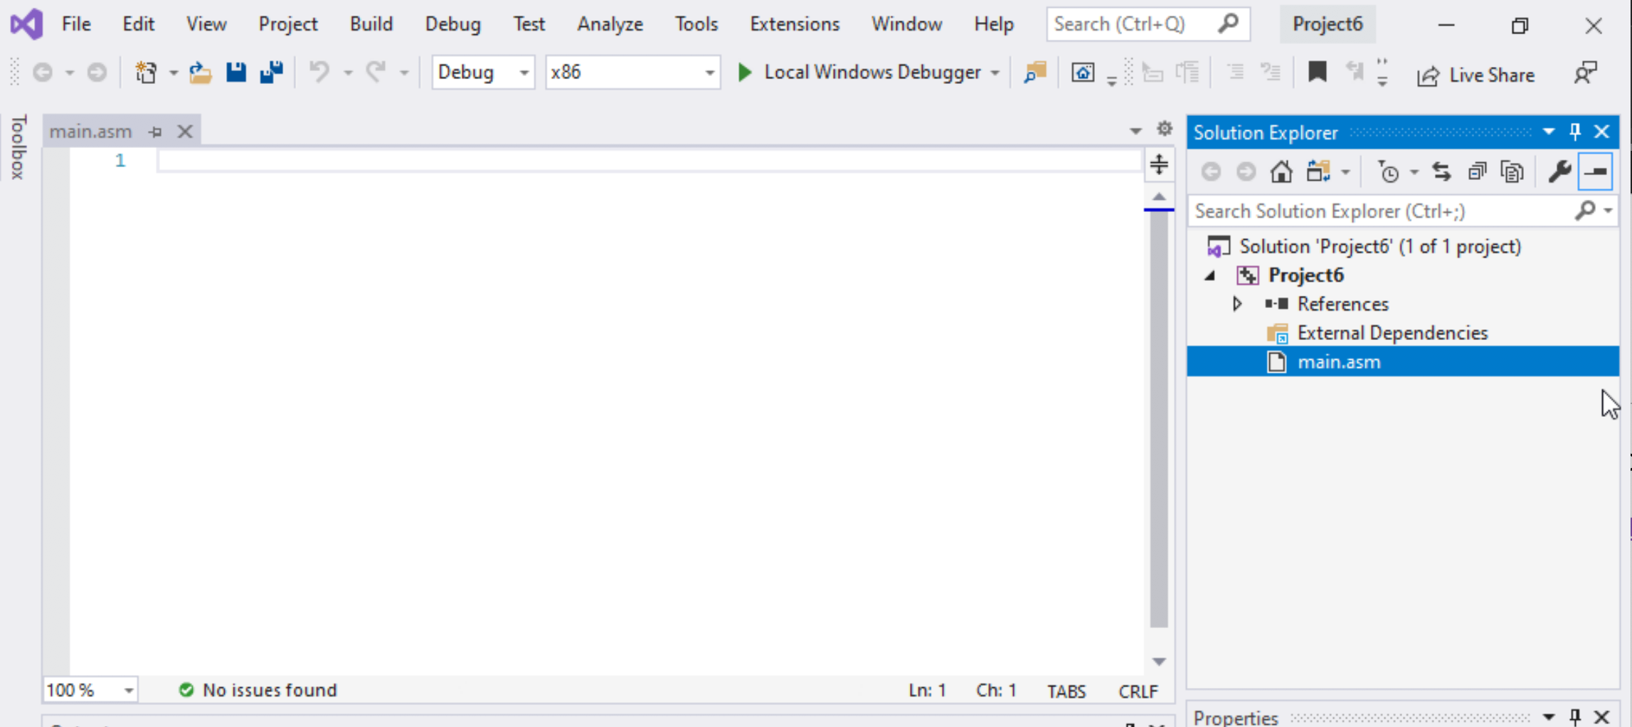

Step 1: Create a project (12)
Select main.asm
Add your code
In the main.asm File.

Slide 20
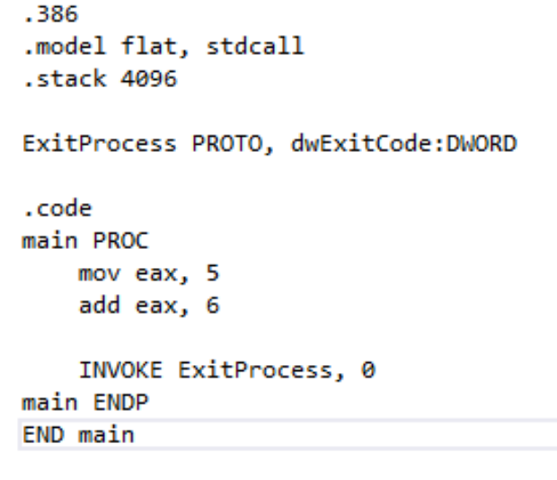
Sample Code
Type the sample code in the main.asm

Slide 21
Listing File
Contains
source code
addresses
object code (machine language)
segment names
symbols (names of : variables, procedures, and constants)
The format of the list file lines is
Notes:
June 16, Sum

Slide 22
Listing File
segment
addresses
source code
object code
Notes:
The symbol table contains the names of all program identifiers, segments, and
related information.

Slide 23
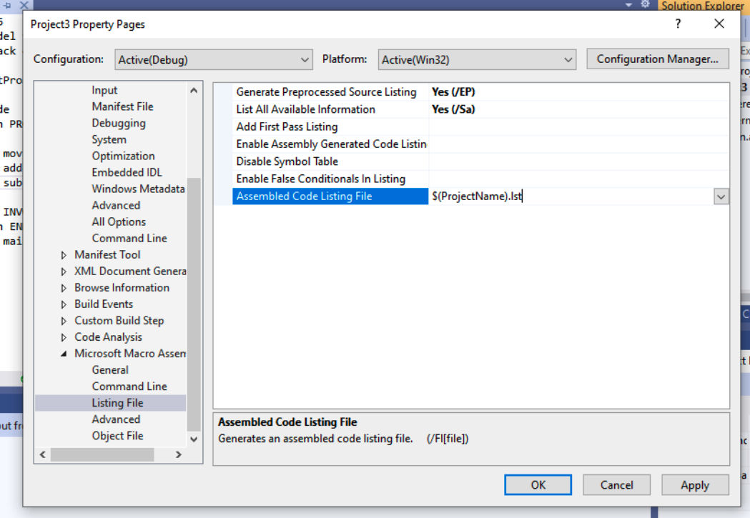
Listing File
Configuring Visual Studio to generate a listing file.
Select Properties from the Project menu.
Under Configuration Properties, select Microsoft Macro Assembler.
In the dialog window,
set Generate Preprocessed Source Listing to Yes,
set List All Available Information to Yes.
Write $(ProjectName).lst in
Assembled Code Listing File

Slide 24
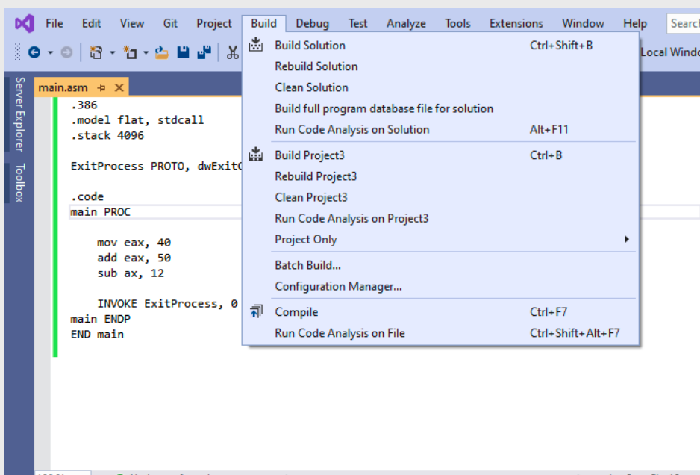


Step 3 : Build the Project
Go to Build tab
Click ‘Build Project’
It is always better to clean the project before building it
To clean the project
Go to build tab
Click ‘Clean project’

Slide 25
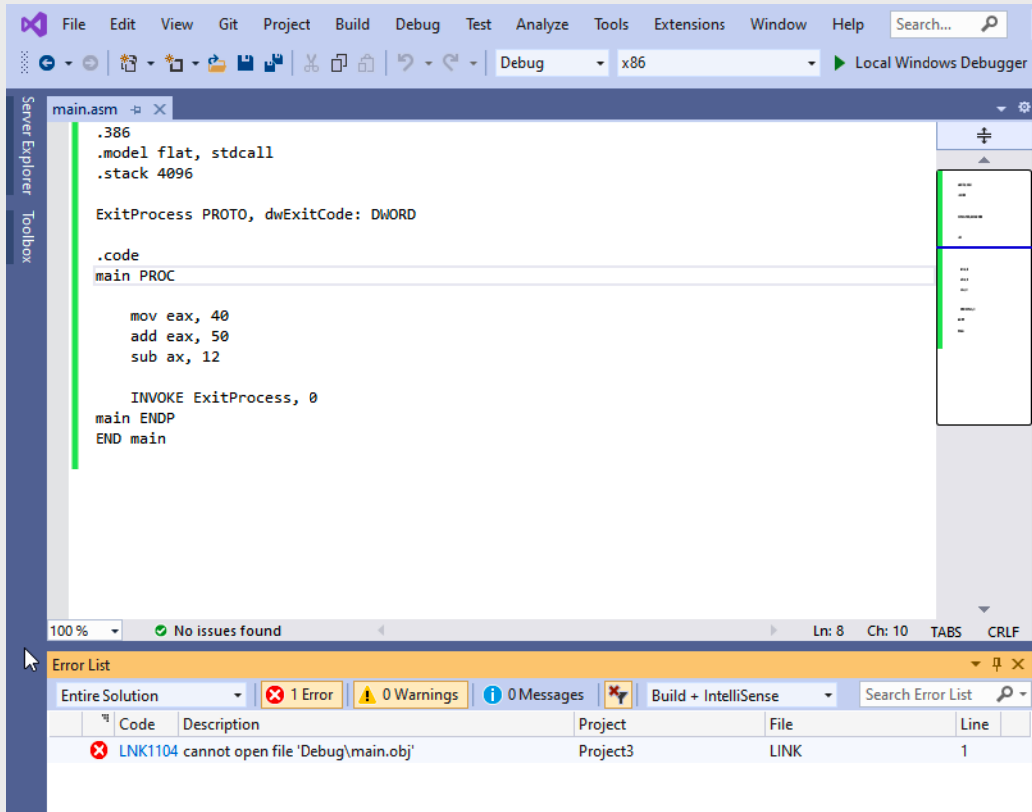


IF you see this error!
Error: LNK 1104: Cannot open file
‘Debug/main.obj’
Follow Steps from slide 25 to 32

Slide 26
IF you see this error!
Error: LNK 1104: Cannot open file
‘Debug/main.obj’
Solution:
Delete the listing file settings from configuration
Clean the project
Build the project again
Then re-enter the listing file settings
Clean the project
Build again

Slide 27
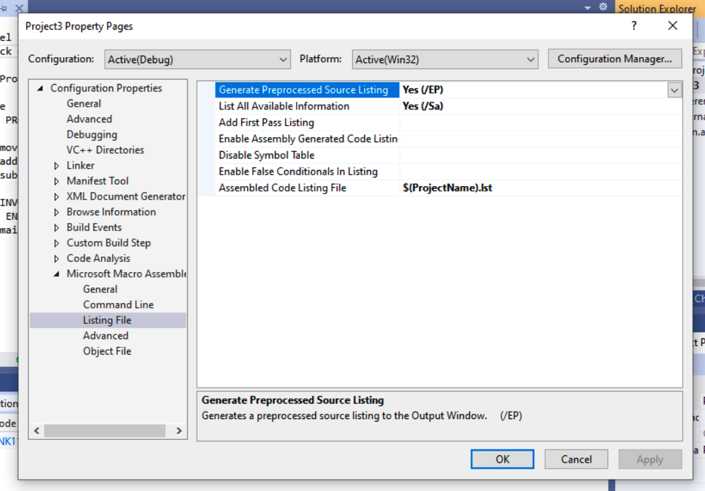
Error Fix: 1. Delete listing file configuration
Go to the Solution explorer
Right click on the Project name in the solution explorer
Click properties
Select Microsoft Macro Assembler
Then choose Listing File

Slide 28
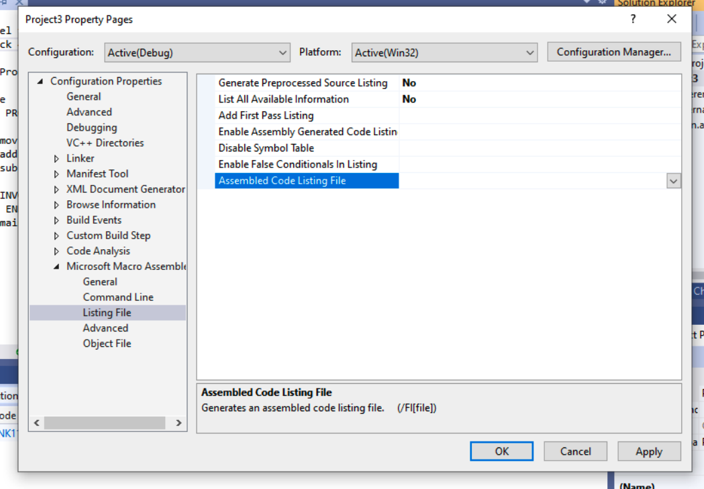


Error Fix: 1. Delete listing file configuration
Set Generate Preprocessed Source Listing to NO,
Set List All Available Information to NO.
Remove $(ProjectName).lst from
Assembled Code Listing File

Slide 29
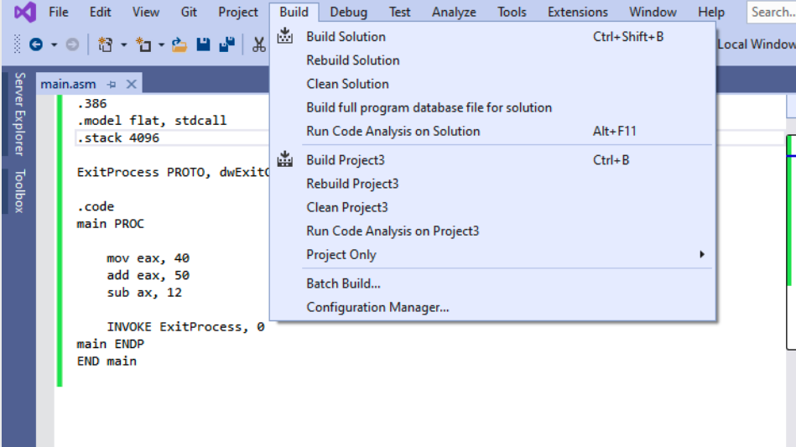


Error Fix: 2. Clean and Build the project (1)
Clean the project
Go to Build -> Clean Project
Build the project
Go to Build -> Build Project

Slide 30
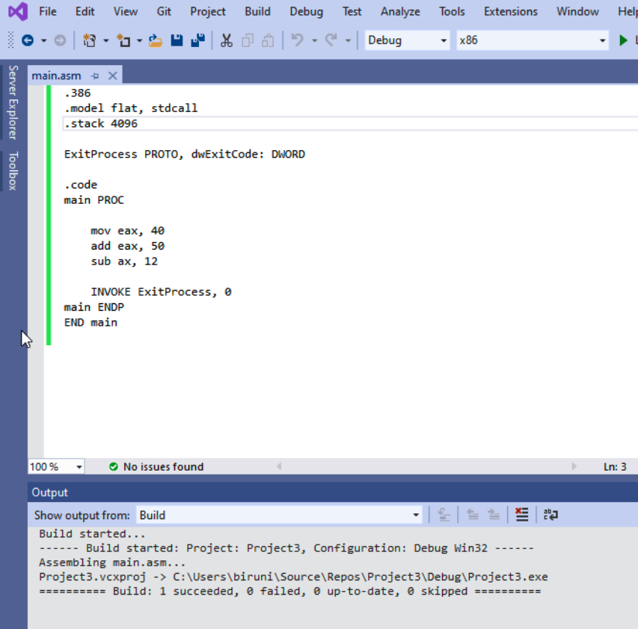


Error Fix: 2. Clean and Build the project (2)
You should see the message showing that build is successful

Slide 31
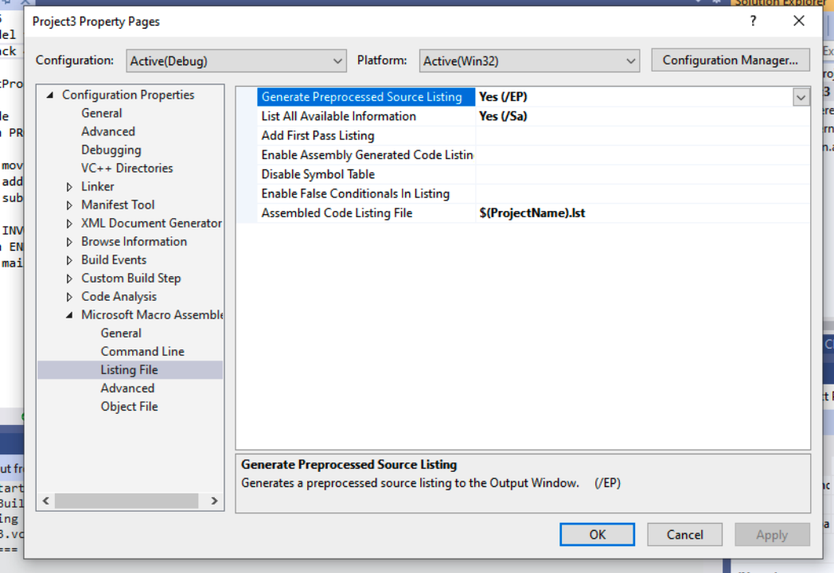
Error Fix: 2. Re-enter listing file configuration
Select Properties from the Project menu.
Under Configuration Properties, select Microsoft Macro Assembler.
In the dialog window,
set Generate Preprocessed Source Listing to Yes,
set List All Available Information to Yes.
Write $(ProjectName).lst in
Assembled Code Listing File

Slide 32
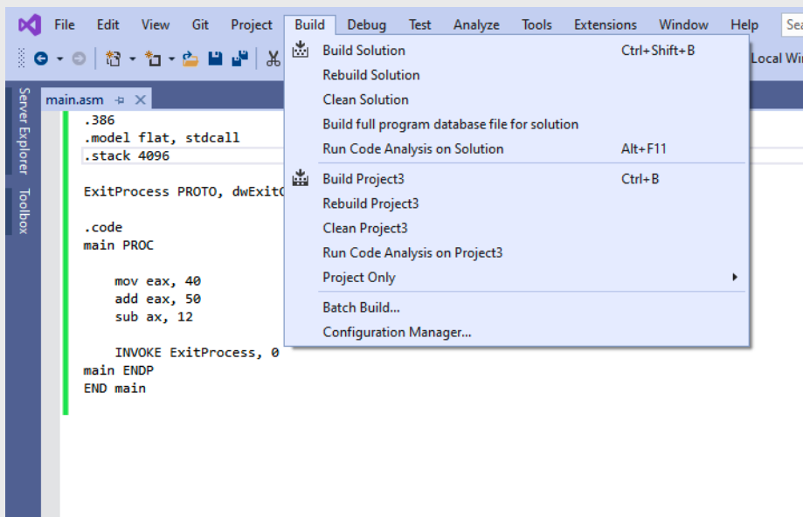




Error Fix: 2. Clean and Build the Project again
Go to Build menu
Click Clean Project
Go to Build menu again
Click Build Project

Slide 33
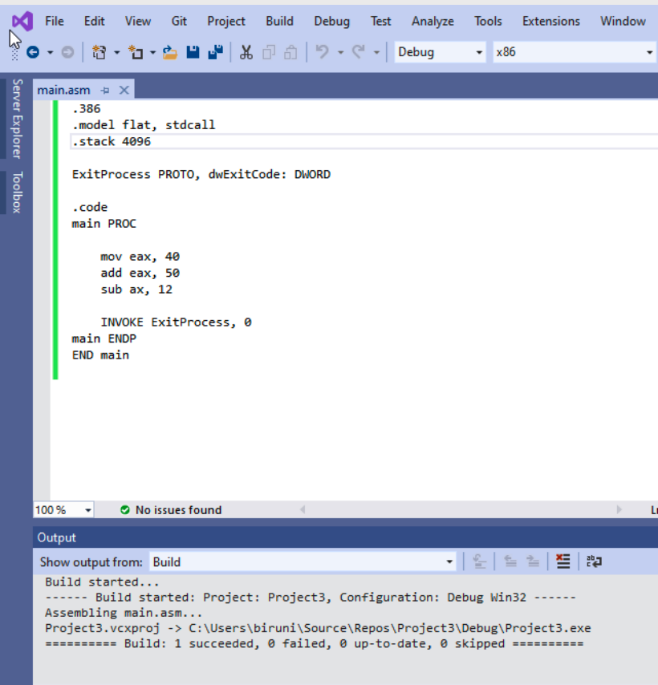



The error should go away
If you still have the error
Then don’t worry about it
This error in the linking phase
So assembler already created the listing file for you.
You can proceed to the next slide.

Slide 34
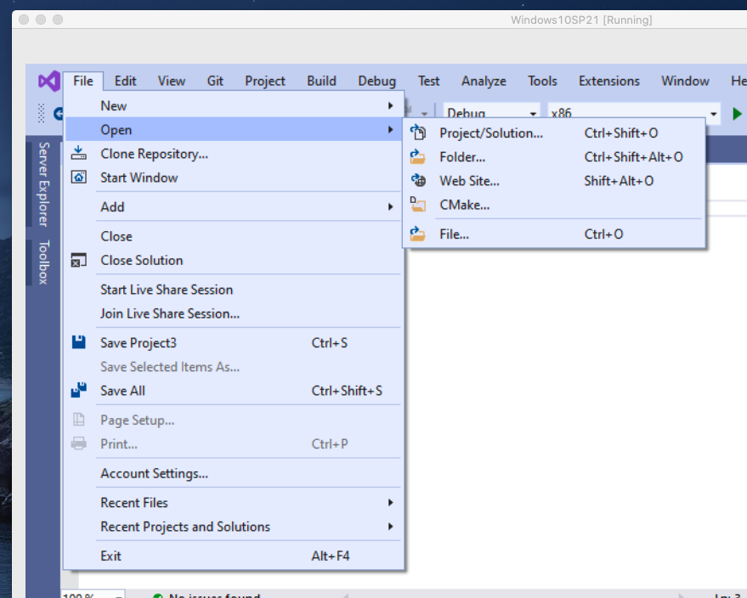
Step 4: Open listing file
Go to the File Tab
Click open
Then choose file

Slide 35
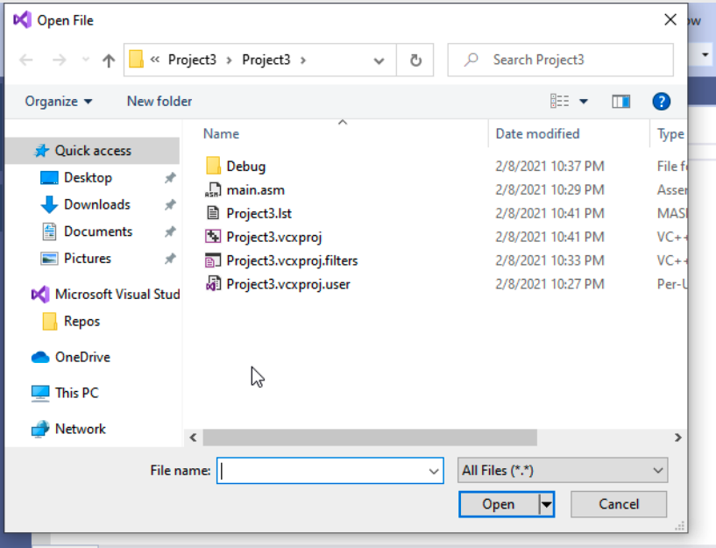

Step 4: Open listing file
The listing file is created with .lst extension
Select .lst file
The listing file have the same name as the project name.

Slide 36
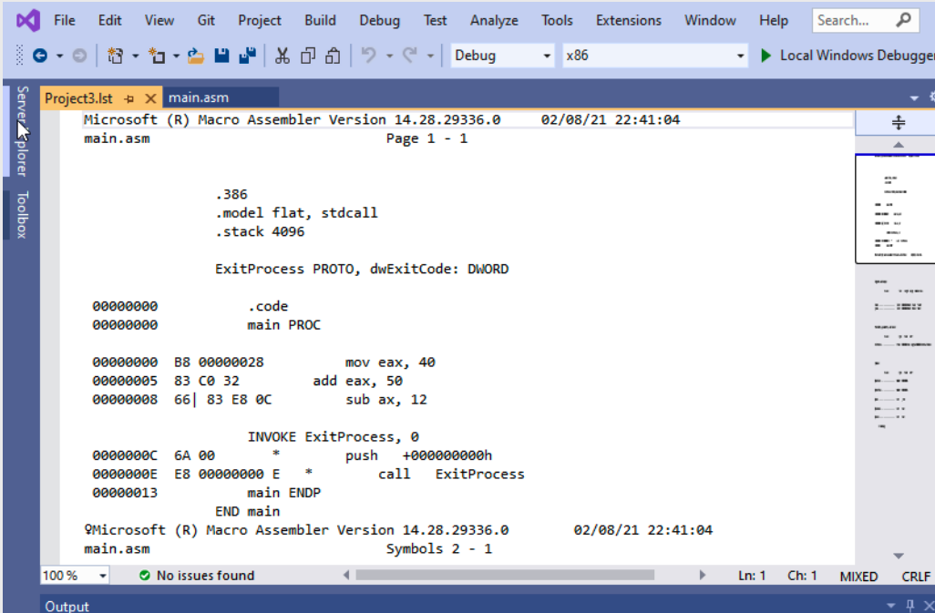
Step 4: Open listing file

Slide 37
Lab 5(a)
Submission Instruction

Slide 38
Problem 1
Write and run a program with following instructions:
mov 20 to AL register
mov 100 to AX register
mov 1000 to EAX register
add 2 to the content of EAX register
subtract 20 from al register
Generate listing file for the program

Slide 39
Submission Instruction
Generate the listing file.
Take a screenshot of the listing file content
Submit the screenshot at iCollege.

Slide 40
Examples
Don’t need to turn in!

Slide 41
Example 1
Which one of the following is a valid identifier ?
_work_var_1
#work_var_1
_1work_var
?work_var_1

Slide 42
Example 1 Answer
Which one of the following is a valid identifier ?
_work_var_1 (correct)
#work_var_1
_1work_var (correct)
?work_var_1 (correct)

Slide 43
Example 2
.data
VAR word 10
.code
mov var, 15
This code will issue an error, because, identifiers are case sensitive. (True/False)

Slide 44
Example 2 answer
No errors
Identifiers are NOT case sensitive

Slide 45
Example 3
The following is a valid multi-line comment :
COMMENT !
This is a comment!
This is a comment!
!

Slide 46
Example 3 Answer
Character ‘!’ is invalid, because it is present in the comment.
Choose a character that is not present in the comment

Slide 47
Example 4
Which of the following variable declarations are valid?
Val DW 12
Val SDWORD -12
Val WORD ABCDh

Slide 48
Example 4 answer
Val DW 12 (valid)
Val SDWORD -12. (valid)
Val WORD ABCDh. (NOT Valid)
Correct declaration : var WORD 0ABCDh

Slide 49
Example 5
What is the little endian representation of the following variable
Var DWORD 87654321h
Given that the first address assigned to the variable is 0000.
0000
0001
0002
0003

Slide 50
Example 5 Answer
What is the little endian representation of the following variable
Var DWORD 87654321h
0000
21
43
65
87
0001
0002
0002

Slide 51
Lab 5(b)
Submission

Slide 52
Data Transfer and Arithmetic Instructions
Write a program to implement the following expression in assembly:
EAX = Xval - (Yval + Zval)
Xval is signed 32-bit integer variable
Yval and Zval are unsigned 32-bit integer variable
Assign Xval 26, Yval 30, and Zval 40.
How to approach this problem and its solution are provided in the upcoming slides.
Make sure you understand the solution

Slide 53
Data Transfer and Arithmetic (add and sub) Instructions
Before writing a program you should know what an instruction can and can not do
Add and subtract can only do the following:
Add or sub register to/from register:
add eax, ebx
Add or sub register to/from memory:
sub mem1, eax
Add or sub memory to/from register:
sub eax, mem1
Add or subtract immediate to/from memory:
add mem1,3
Add or subtract immediate to/from register:
add eax,3

Slide 54
Data Transfer and Arithmetic (add and sub) Instructions
Before writing a program you should know what an instruction can and can not do
Add and subtract can NOT do the following
Add or sub memory to/from memory:
sub mem1,mem2 or add mem1,mem2
- The same apply for mov instruction

Slide 55
Data Transfer and Arithmetic (add and sub) Instructions
.386
.model flat, stdcall
.stack 4096
ExitProcess PROTO, dwExitCode: DWORD
Create a new Project to run the following program.
Build and run the program using the debugger
Examine the content of the registers
Explain the content of the registers and variables
; EAX = Xval - (Yval + Zval)
.data
Xval SDWORD 26
Yval DWORD 30
Zval DWORD 40
.code
main proc
; second term: (Yval + Zval)
mov ebx,Yval
add ebx,Zval
; sub the terms and store:
sub Xval,ebx
mov eax,Xval
invoke ExitProcess, 0
main ENDP
END main
; parenthesis have higher precedence, do them first

Slide 56
Submission Instruction
Debug the code until the ‘invoke ExitProcess, 0’. Attach screenshot showing the content of AX register at the end along with the code.

Slide 57
Lab 5(c)
Submission

Slide 58
Defining Data: Using the DUP Operator
Use DUP to allocate (create space for) an array or string.
Syntax: counter DUP ( argument )
Counter and argument must be constants or constant expressions
var1 BYTE 20 DUP(0) ; 20 bytes, all equal to zero
var2 BYTE 20 DUP(?) ; 20 bytes, uninitialized
var3 BYTE 4 DUP("STACK") ; 20 bytes: "STACKSTACKSTACKSTACK"
var4 BYTE 10,3 DUP(0),20 ; 5 bytes
Notes:
Sec 03 Feb 09

Slide 59
Dup Operator
Create a new application to run the following program.
Build and run the program using the debugger
Examine the content of the register AX
mov ax,myWord+0 ;sum up the list values
add ax, myWord + 2
add ax, myWord + 4
add ax, myWord + 6
add ax, myWord + 8
invoke ExitProcess,0
main endp
end main
; summation of the list values.
.386
.model flat, stdcall
.stack 4096
ExitProcess proto, dwExitCode:dword
.data
myWord word 4 dup(1,2,3,4,5)
.code
main proc
mov eax,0 ; zeroing eax
Note: Section Appendix has a reference to how to create a new project.

Slide 60
Submission Instruction
Debug the code
Answer the questions in the answer sheet.
What is the total size of the myWord array?
Debug the code until the ‘invoke ExitProcess, 0’. Attach screenshot showing the content of AX register at the end along with the code.

Slide 61
Lab 5(d)
Submission

Slide 62
$ Operator
Create a new application to run the following program.
Build and run the program using the debugger
Examine the content of the register AL (convert the value to decimal to see length of the string)
; Calculating the size of the String
.386
.model flat, stdcall
.stack 4096
ExitProcess proto, dwExitCode:dword
.data
myString byte "This is a very long string made by your instructor to test how $ works in this lab hope you will like it"
myString_length = ($ - myString)
.code
main proc
mov eax,0
mov al, myString_length
invoke ExitProcess,0
main endp
end main
Note: Section Appendix has a reference to how to create a new project.

Slide 63
Submission Instruction
Debug the code
Answer the questions in the answer sheet.
What is the difference between symbolic constant and variables?
Debug the code until ‘invoke ExitProcess, 0’. Attach the screenshot showing the content of al register at the end along with the code.

